Slide 1
Cryptography and Network Security
Lecture 5: Classical encryption

Slide 2
Outline
Conventional Encryption Principles
Conventional Encryption Algorithms
Cipher Block Modes of Operation
Location of Encryption Devices
Key Distribution

Slide 3
Background
Cryptography is the science of writing in secret code
Ancient art;
  the first documented use of cryptography in writing dates back to 1900 B.C.
  Egyptian scribe used non-standard hieroglyphs in an inscription. Some experts argue that cryptography appeared spontaneously sometime after writing was invented, with applications ranging from diplomatic missives to war-time battle plans.

Slide 4
Secret-key cryptography
Will cover more than half of this course
I.1 Secret-key cryptography
Also called symmetric or conventional cryptography
Five ingredients
  Plaintext
  Encryption algorithm: runs on the plaintext and the encryption key to yield the cipher text
  Secret key: an input to the encryption algorithm, value independent of the plaintext; different keys will yield different outputs
  Cipher text: the scrambled text produced as an output by the encryption algorithm
  Decryption algorithm: runs on the cipher text and the key to produce the plaintext
Requirements for secure conventional encryption
  Strong encryption algorithm
    An opponent who knows one or more cipher texts would not be able to find the plaintexts or the key
    Ideally, even if he knows one or more pairs plaintext-cipher text, he would not be able to find the key
Sender and receiver must share the same key. Once the key is compromised, all communications using that key are readable
It is impractical to decrypt the message on the basis of the cipher text plus the knowledge of the encryption algorithm
encryption algorithm is not a secret

Slide 5
Cryptography –some notations
Notation for relating the plaintext, cipher text, and the keys
  C=EK(P) denotes that C is the encryption of the plaintext P using the key K
  P=DK(C) denotes that P is the decryption of the cipher text C using the key K
  Then DK(EK(P))=P

Slide 6
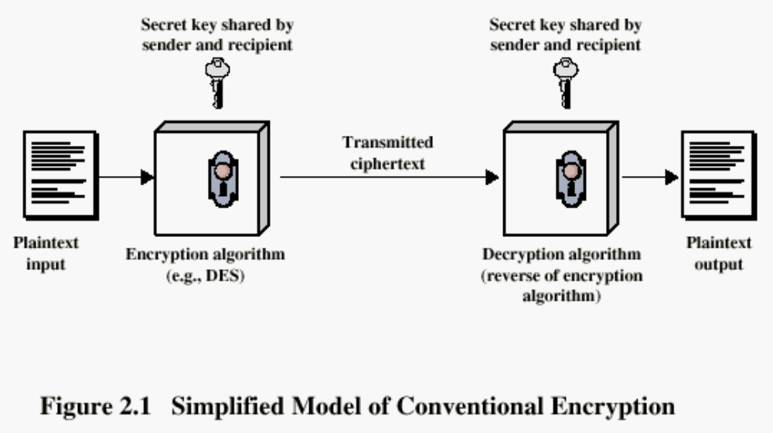
Conventional Encryption Principles

Slide 7
Disadvantage of symmetric crypto
The disadvantage of symmetric cryptography is that it presumes two parties have agreed on a key and been able to exchange that key in a secure manner prior to communication. This is a significant challenge

Slide 8
Cryptography
Classified along three independent dimensions:
  The type of operations used for transforming plaintext to cipher text
  The number of keys used
    symmetric (single key)
    asymmetric (two-keys, or public-key encryption)
  The way in which the plaintext is processed

Slide 9
Cryptanalysis & Brute force
Cryptanalysis:
  refers to the study of ciphers, ciphertext, with a view to finding weakness in them that will permit retrieval of the plaintext from the ciphertext , without knowing the key or the algorithm. This is known as breaking cipher, or ciphertext.
Brute-force attack:
  The attacker tries every possible key on a piece of ciphertext until an intelligible translation into plaintext is obtained. On average, half of all possible keys must be tried to achieve success.

Slide 10
Caesar Cipher
Mathematically give each letter a number
  a b c d e f g h i j k l m n o p q r s t u v w x y z
  0 1 2 3 4 5 6 7 8 9 10 11 12 13 14 15 16 17 18 19 20 21 22 23 2425
The key is a number from 0 to 25
Caesar cipher can now be given as
A TRANSPOSITION TECHNIQUE

Slide 11
Caesar Cipher
It is a typical substitution cipher and the oldest known –attributed to Julius Caesar
Simple rule: replace each letter of the alphabet with the letter standing 3 places further down the alphabet
For decryption move back ward
Example:
  MEET ME AFTER THE TOGA PARTY
  PHHW PH DIWHU WKH WRJD SDUWB
Here the key is 3 –choose another key to get a different substitution
The alphabet is wrapped around so that after Z follows A:
a b c d e f g h i j k l m n o p q r s t u v w x y z
D E F G H I J K L M N O P Q R S T U V W X Y Z A B C

Slide 12
Attacking Caesar
Caesar can be broken if we only know one pair (plain letter, encrypted letter)
  The difference between them is the key
Caesar can be broken even if we only have the encrypted text and no knowledge of the plaintext
  Brute-force attack is easy: there are only 25 keys possible
  Try all 25 keys and check to see which key gives an intelligible message

Slide 13
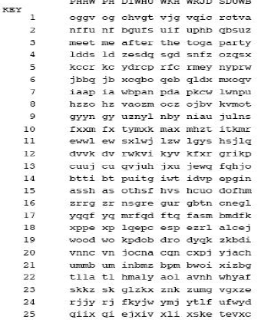
Why is Caesar easy to break?􀂄
Only 25 keys to try􀂄
The language of the plaintext is known and easily recognizable

Slide 14
Another example
Key Text
0 exxegoexsrgi
1 dwwdfndwrqfh
2 cvvcemcvqpeg
3 buubdlbupodf
4 attackatonce
5 zsszbjzsnmbd
6 yrryaiyrmlac...
23 haahjrhavujl
24 gzzgiqgzutik
25 fyyfhpfytshj

Slide 15
Strengthening Caesar: monoalphabetic ciphers
Caesar only has 25 possible keys –far from secure
Idea: instead of shifting the letters with a fixed amount how about allowing any permutation of the alphabet
  Plain: a b c d e f g h I j k l m n o p q r s t u v w x y z
  Cipher: D K V Q F I B J W PE S C X H T M Y A U O L R G Z N
  Plaintext: if we wish to replace letters
  Cipher text: WI RF RWAJ UH YFTSDVF SFUUFYA
This is called monoalphabetic substitution cipher–a single alphabet is used
The increase in the number of keys is dramatic: 26!, i.e., more than 400,000,000,000,000,000,000,000,000 such rearrangements

Slide 16
Monoalphabetic ciphers
Having SO MANY possible keys appears to make the system challenging: difficult to perform brute-force attacks
􀂄There is however another line of attack that easily defeats the system even when a relatively small ciphertext is known
  If the cryptanalyst knows the nature of the text, e.g., non compressed English text, then he can exploit the regularities of the language

Slide 17
Language redundancy and cryptanalysis
Human languages are redundant
􀂄Letters are not equally commonly used
  􀂉In English E is by far the most common letter
  􀂉Follows T,R,N,I,O,A,S
  􀂉Other letters are fairly rare
    􀂄See Z,J,K,Q,X
􀂄Tables of single, double & triple letter frequencies exist
  􀂉Most common diagram in English is TH
  􀂉Most common trigram in English in THE
Here is the cipher text:
  Ftt bdv bfhvq efno ukvj f tnmvbnxv ic bdv fkvjfyv Fxvjnlfz fjv qevzb ic bdv yukvjzxvzb nz tvqq bdfz f qvluzo.
All the taxes paid over a lifetime by the average American are spent by the government in less than a second

Slide 18
Cryptanalysis of monoalphabetic ciphers
Key concept –mono alphabetic substitution ciphers do not change relative letter frequencies
  Discovered by Arabs in the 9thcentury
Calculate letter frequencies for cipher text
Compare counts/plots against known values
    Most frequent letter in the cipher text may well encrypt E
    The next one could encrypt T or A
    After relatively few tries the system is broken
    If the cipher text is relatively short (and so, the frequencies are not fully relevant) then more guesses may be needed
Powerful tool: look at the frequency of two-letter combinations (diagrams)

Slide 19
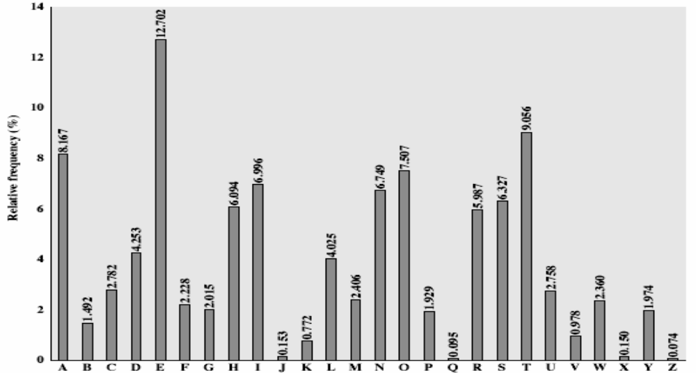
English Letter Frequencies

Slide 20
Breaking contd
Let’s count some letters. The most common letter is V, followed by F, N, B, Z
The most common English letters are ETAIN… it is highly likely that we have some matches here – though it is not a certainty. Also ‘F’ probably stands for I or A as ‘F’ appears alone more than once
It should also be noted that where V ends a three letter word, that word is ‘BDV’. The most common trigraph (three letter sequence) in English is ‘THE’ – so let us guess that ‘BDV’is ‘THE’.
The sequence ‘BDFZ’ gives a little hope, as f is likely to
be ‘A’ or ‘I’ then ‘BDFZ’ could be ‘THIS’ or ‘THAN’ (not ‘THAT’

Slide 21
Breaking contd
What else can we establish? Either N or Z is likely to be a vowel (‘NZ’) – and so is I or C (‘IC’).
Looking at the first word, Ftt – F is likely to be A or I,
so what could this be?
ADD
AHH
ALL
ANN
ASS
Resonable one is ALL
BDFZ’ is ‘THAN’

Slide 22
Breaking contd
All the ta e a e a l et e the
Ftt bdv bfhvq efno ukvj f tnmvbnxv ic bdv

Slide 23
Determining the Difficulty of a Brute Force Attack
The difficulty of a brute force attack depends on several factors, such as:
  How long can the key be?
  How many possible values can each component of the key have?
  How long will it take to attempt each key?
  Is there a mechanism which will lock the attacker out after a number of failed attempts?

Slide 24
Average time required for exhaustive key search
Key Size (bits) | Number of Alternative Keys | Time required at 10⁶ Decryption/µs
32 | 2³² = 4.3 x 10⁹ | 2.15 milliseconds
56 | 2⁵⁶ = 7.2 x 10¹⁶ | 10 hours
128 | 2¹²⁸ = 3.4 x 10³⁸ | 5.4 x 10¹⁸ years
168 | 2¹⁶⁸ = 3.7 x 10⁵⁰ | 5.9 x 10³⁰ years

Slide 25
Substitution techniques
A study of these techniques enables us to illustrate the basic approaches to symmetric encryption
A substitution technique is one in which the letters of plaintext are replaced by other letters or by numbers or symbols
The two basic building blocks of all encryption techniques are substitution and transposition

Slide 26
Play fair Cipher
The Playfair Cipher is an example of multiple-letter encryption
Invented by Sir Charles Wheatstone in 1854, but named after his friend Baron Play fair who championed the cipher at the British foreign office
Based on the use of a 5x5 matrix in which the letters of the alphabet are written (I is considered the same as J)
This is called key matrix

Slide 27
Playfair Matrix
􀂄A 5X5 matrix of letters based on a keyword
􀂄Fill in letters of keyword (no duplicates)
  􀂉Left to right, top to bottom
􀂉Fill the rest of matrix with the other letters in alphabetic order
􀂄E.g. using the keyword MONARCHY, we obtain the following matrix
M O N A R
C H Y B D
E F G I K
L P Q S T
U V W X Z

Slide 28

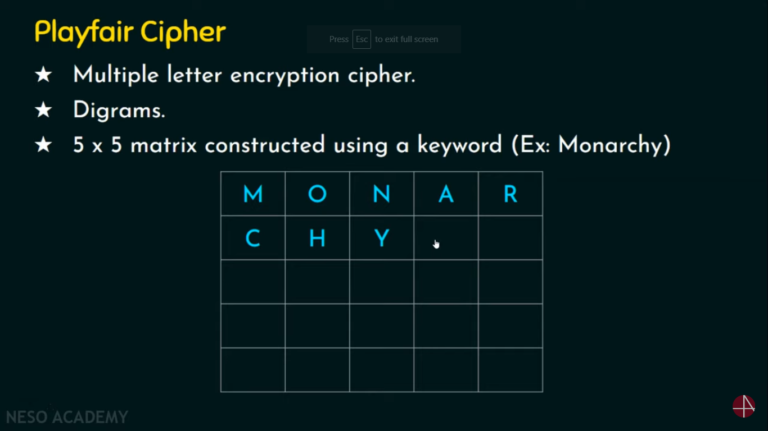

Slide 29
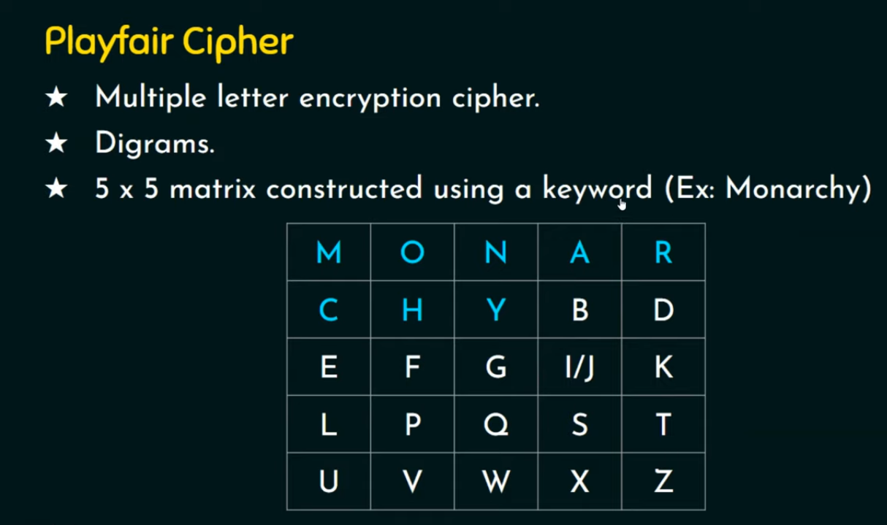

Slide 30
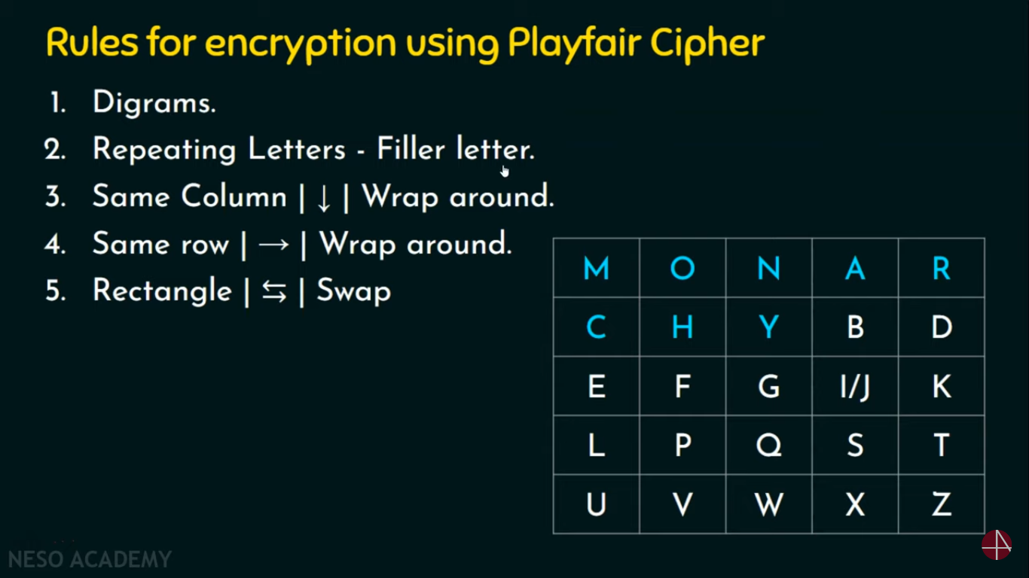

Slide 31
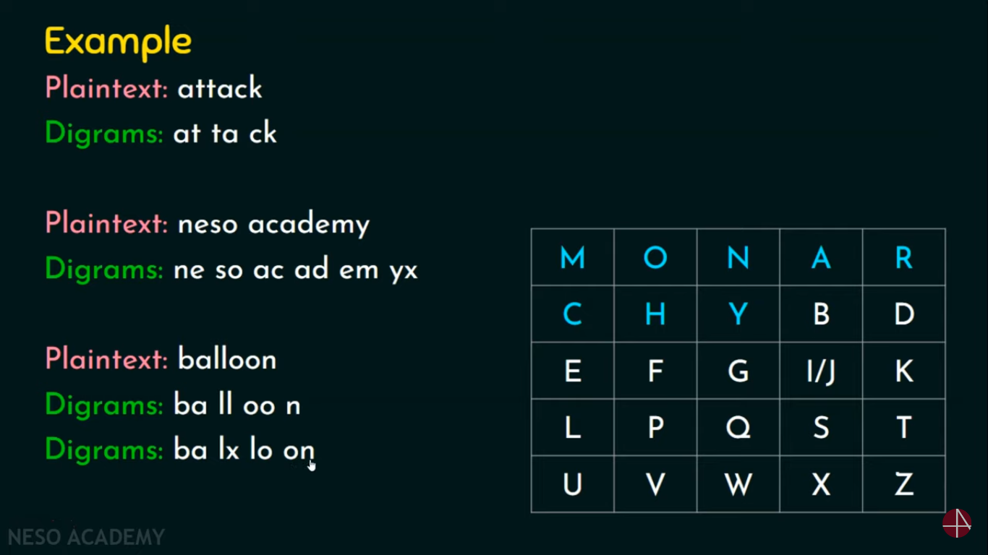

Slide 32
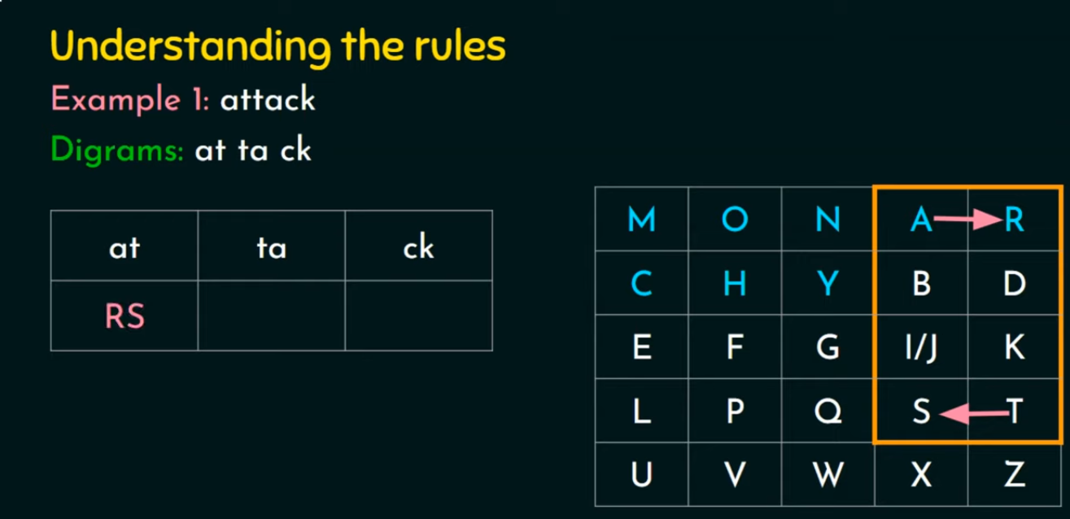

Slide 33


Slide 34
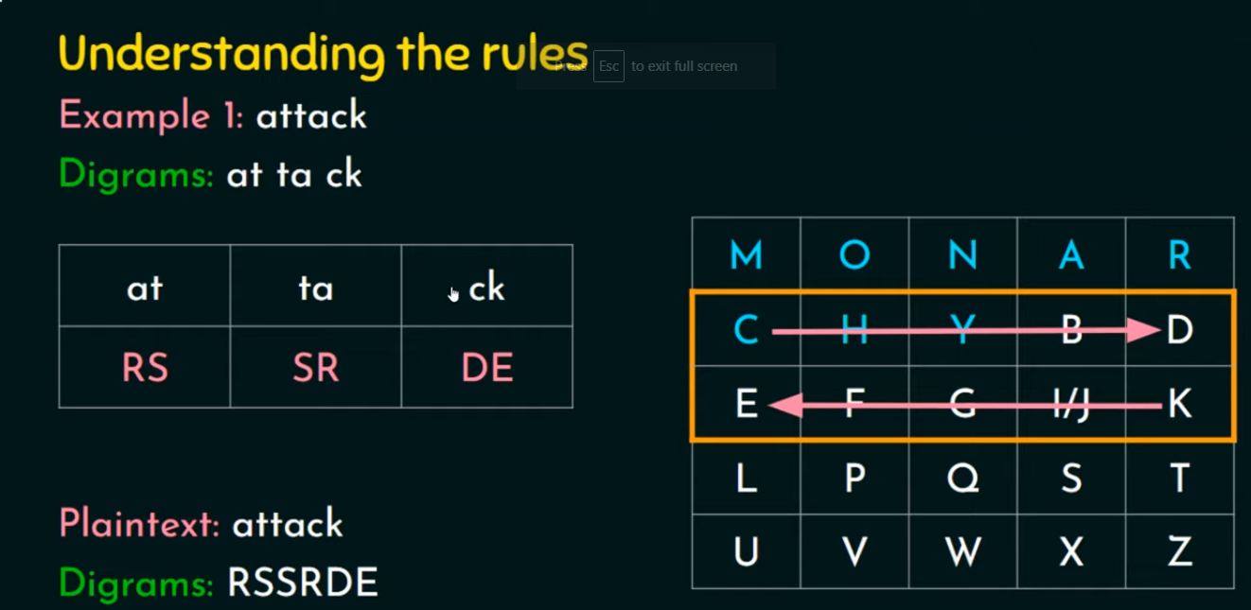

Slide 35
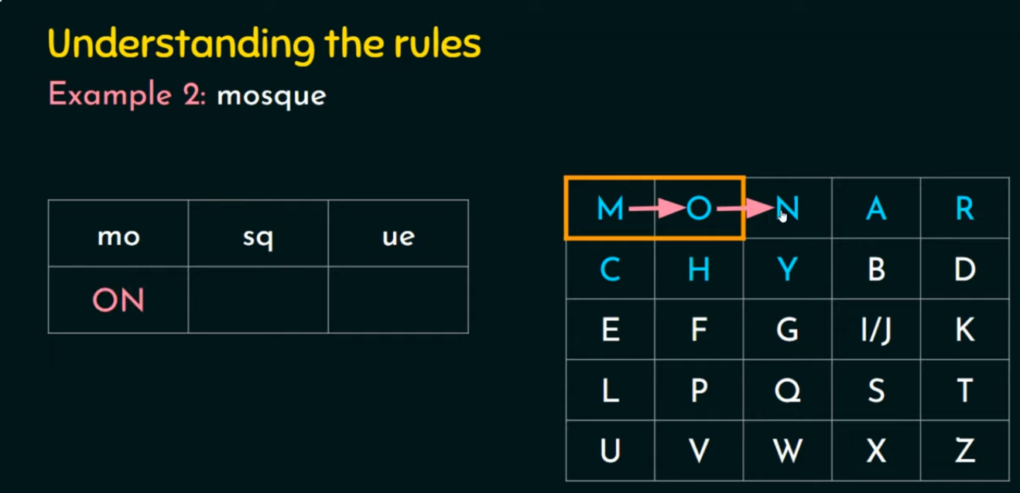

Slide 36
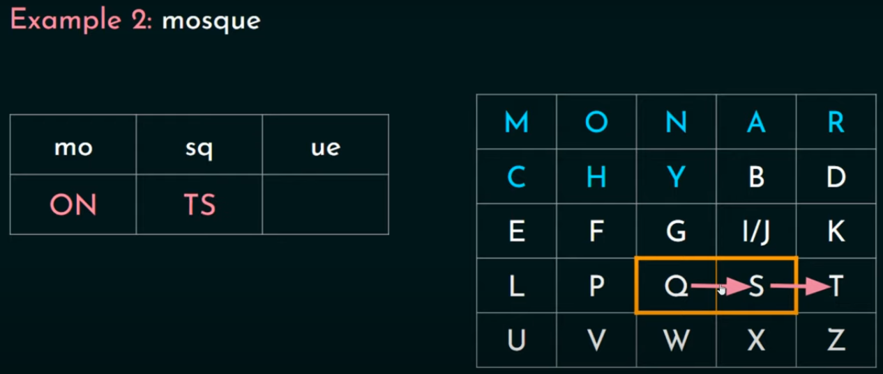

Slide 37
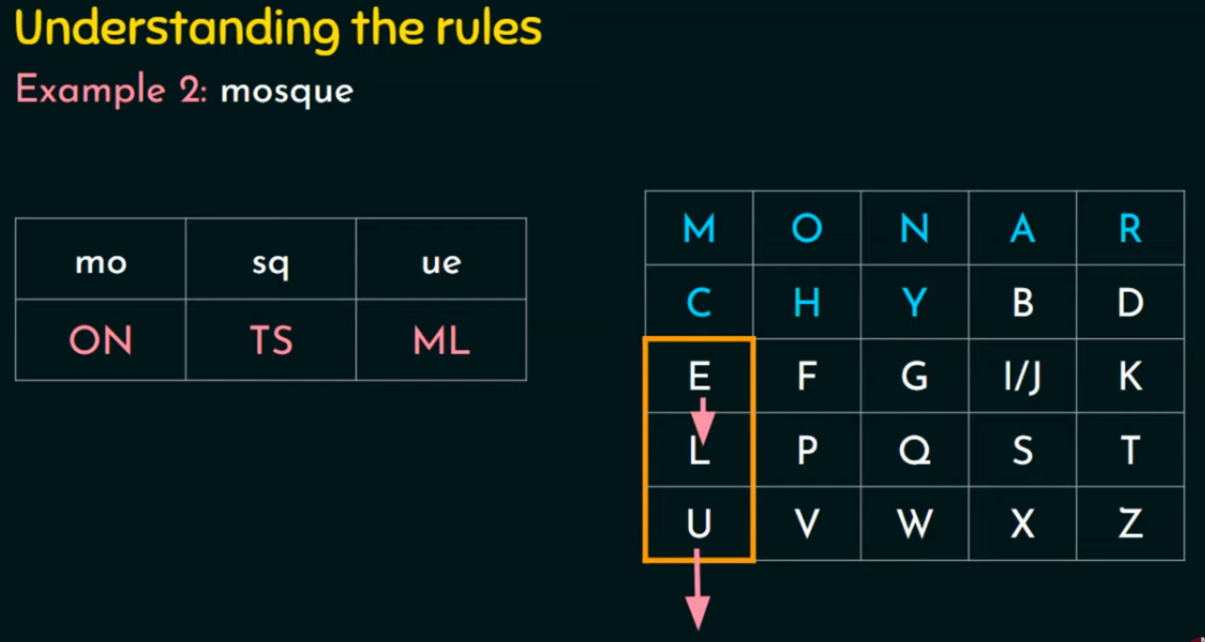

Slide 38
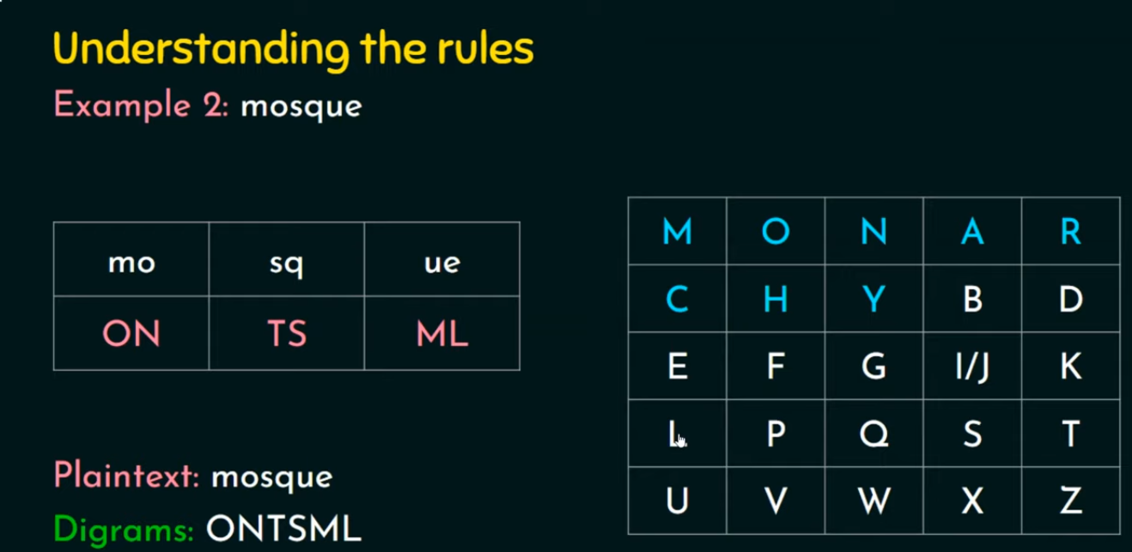

Slide 39
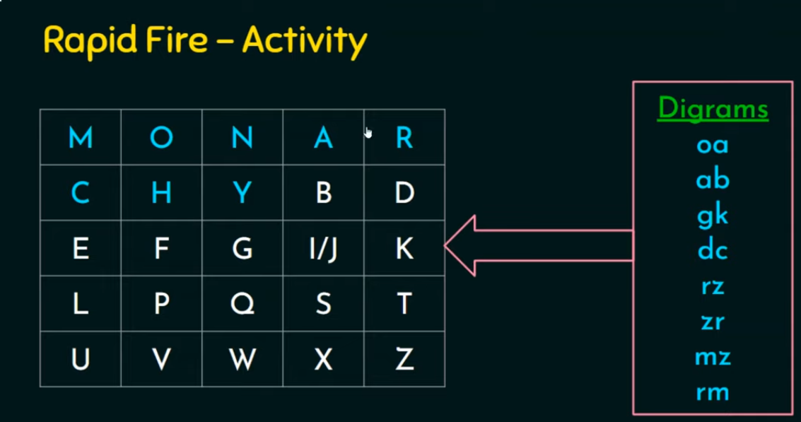

Slide 40
Encrypting and decrypting with Playfair
The plaintext is encrypted two letters at a time:
1 .Break the plaintext into pairs of two consecutive letters
2. If a pair is a repeated letter, insert a filler like 'X‘ in the plaintext, eg. "balloon" is treated as "ba lx lo on"
3. If both letters fall in the same row of the key matrix, replace each with the letter to its right (wrapping back to start from end), eg. “AR" encrypts as "RM"
4. If both letters fall in the same column, replace each with the letter below it (again wrapping to top from bottom), eg. “MU" encrypts to "CM"
5. Otherwise each letter is replaced by the one in its row in the column of the other letter of the pair, eg. “HS" encrypts to "BP", and “EA" to "IM" or "JM" (as desired)
􀂄Decryption works in the reverse direction
􀂄The examples above are based on this key matrix:
M O N A R M O N A R
C H Y B D C HY BD
E F G I K E F G I K
L P Q S TL PQ ST
U V W X Z U V W X Z

Slide 41
Security of Playfair
Security much improved over monoalphabetic
  There are 26 x 26 = 676 diagrams
Needs a 676 entry diagram frequency table to analyse (vs. 26 for a monoalphabetic) and correspondingly more cipher text
Widely used for many years (eg. US & British military in WW I, other allied forces in WW II)
Can be broken, given a few hundred letters
  Still has much of plaintext structure

Slide 42
Measures to hide the structure of the plaintext
1.Encrypt multiple letters of the plaintext at once
2.Use more than one substitution in encryption and decryption (polyalphabeticciphers)
To be continued . . . . . . . . Next Class
More Cryptography Techniques

